Slide 1


Mini project-KIET_ADMIN Mentor –Vipin Kumar
By- Prachi Singh
Priyanka Patel

Slide 2
Kiet_admin
This app is designed for college administrators .
For authentication purpose, the administrator itself need to first register and then login every time they use it .
The working for administrator is easy to do as they can add or remove any faculty according to their needs.
It help the faculty to deliver stuffs to the students and the study materials and manage record keeping.
The main reason for making this was that we could show all the things at one place.
For example. Upload Notice ,Images related to functions, eBooks etc.
This is the platform where a higher authorities can access it and share information.
At the time of changes done by administrator like upload notice, upload eBooks etc. the user will get instant notification about those changes .

Slide 3
SCOPE
Provide the information to the users, eBooks, notice etc.
Show the description and information about different modules and relevant details about the faculties.
It increase the efficiency of managing the information for users.
It reduce paper work.

Slide 4
BENEFITS
The most obvious benefits of this app include the development of knowledge amongst the users and the faculties.
First it gives an organization somewhere to centrally house its work and development content. It can be stored ,managed ,update, deleted from within the same software.
With this ,learners can access their e-learning environment from anywhere ,anytime.
It is easy to integration .
It has good content management.

Slide 5
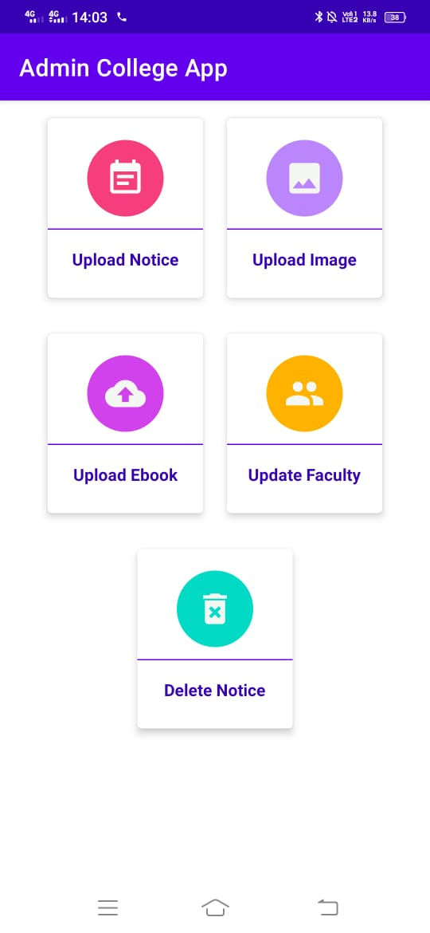
DASHBOARD
This is the first page where all the modules are available and based on the requirements ,the administrator can do changes .

Slide 6
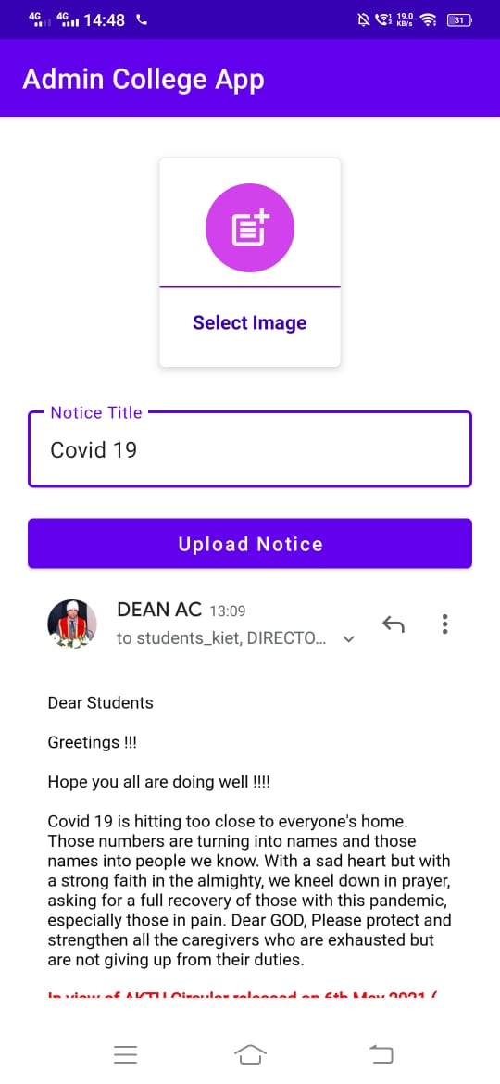
UPLOAD NOTICE
The notice related to any information can be uploaded here and this is one of most important feature of this app.
Also as mentioned above the notification will be auto send to the uses.

Slide 7
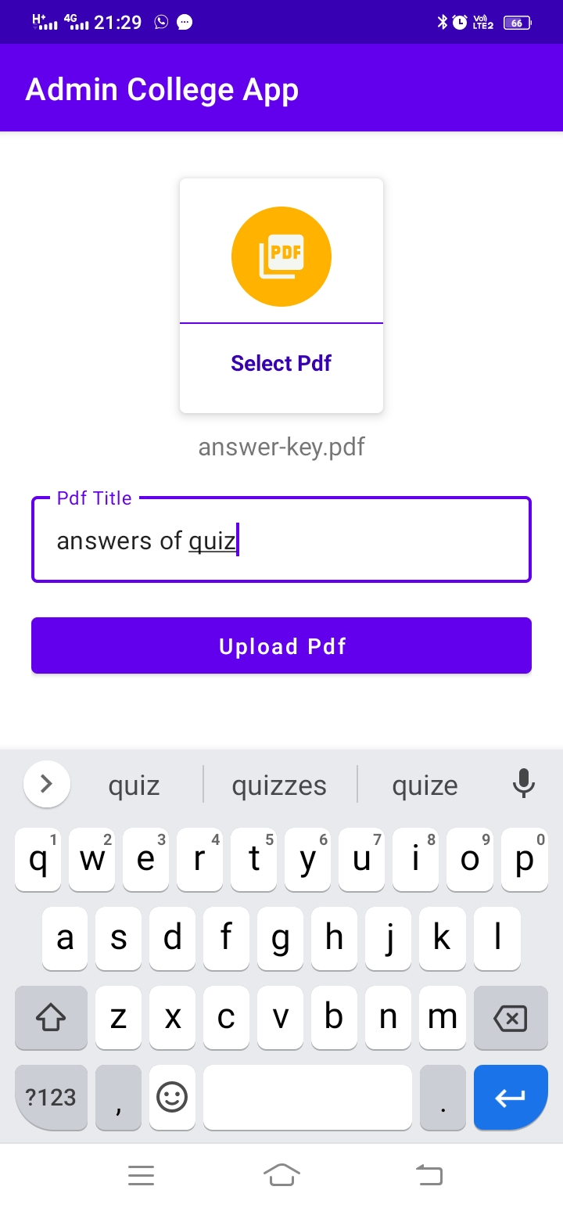
UPLOAD E_BOOKS
Administrator can upload the pdf of e-books which will be helpful to learn online and get all the available materials.
Users can download or share the eBooks .Even they can read without downloading them .

Slide 8
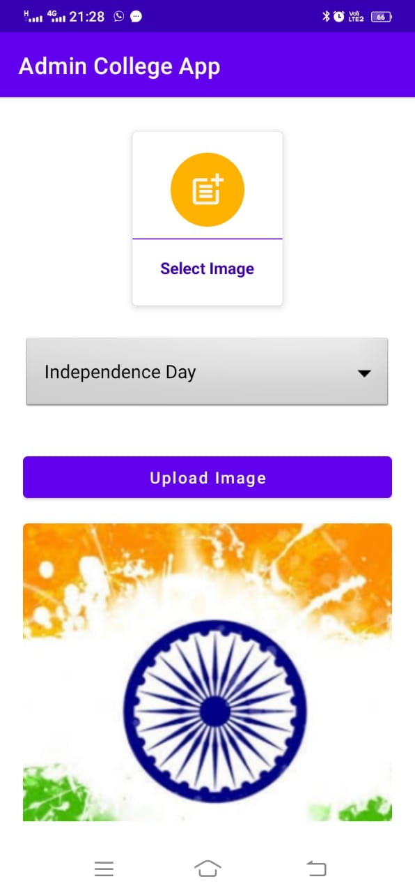
UPLOAD IMAGE
Firstly, Administrator will select the events for which they wants to upload images for any category.
After by selecting image they can upload image.

Slide 9
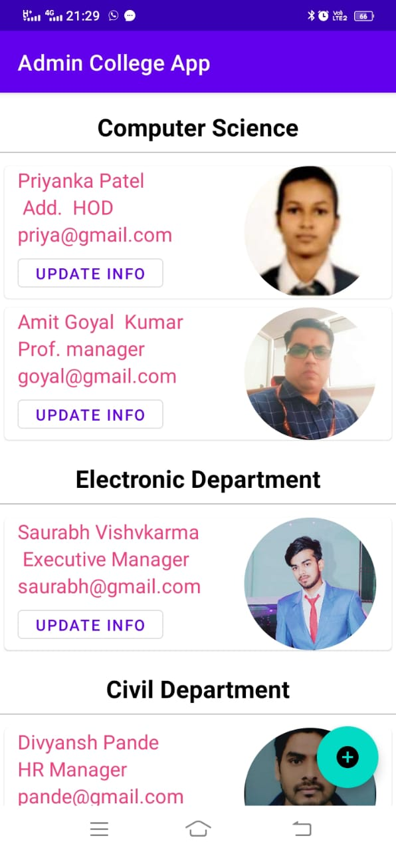
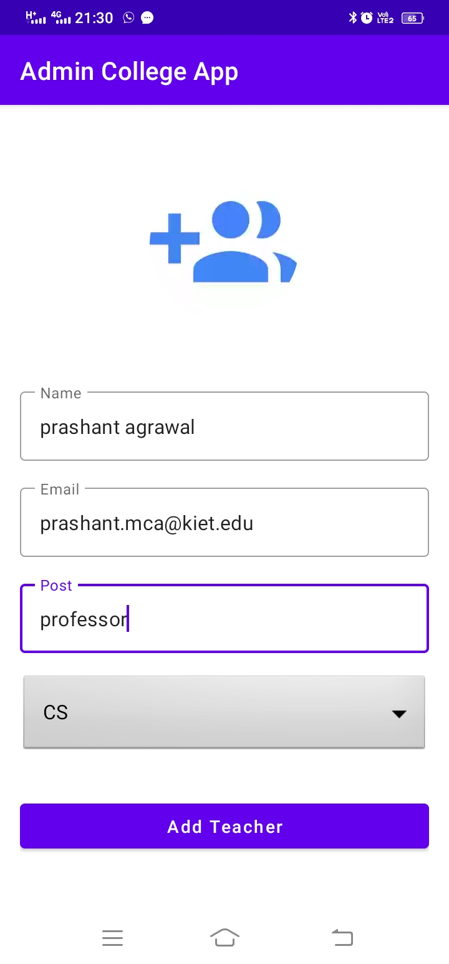
UPLOAD FACULTY
Here, all the details are related to faculty only.
While adding the details of new faculty certain personal details are mandatory to fill.
Also there are options where the administrator can update or delete the details of faculties.

Slide 10
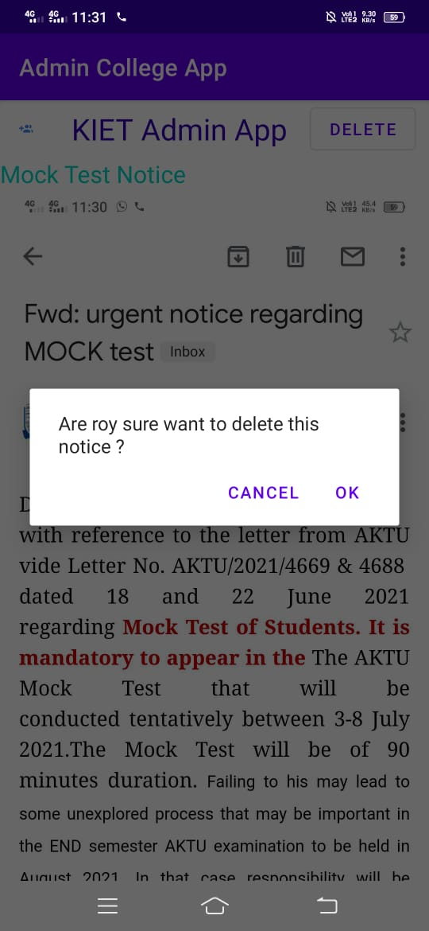
DELETE NOTICE
This is the area where administrator can delete any uploaded message .They will receive a confirmation message as it is shown here before actually deleting the content.

Slide 11
Conclusion
This app is designed for college administrators.
Delivering the material to the users will be very easy.
Database is secured.
Reduce lots of paper work.

Slide 12
THANK YOU

